Slide 1
Education in the bay area
Jitka
Paul Song
Teresa Lee
Ray
Mauricio Perez

Slide 2
The project
What we wanted to get to know

Slide 3

Our webpage
Our main objective was to understand the main demographics that influence the school rating of schools in the Bay Area.
We used several public datasets and APIs available to cross reference our data and find the correlation between some key demographics and the school ratings on GreatSchools.

Slide 4
The map
California schools have over all a great rating

Slide 5
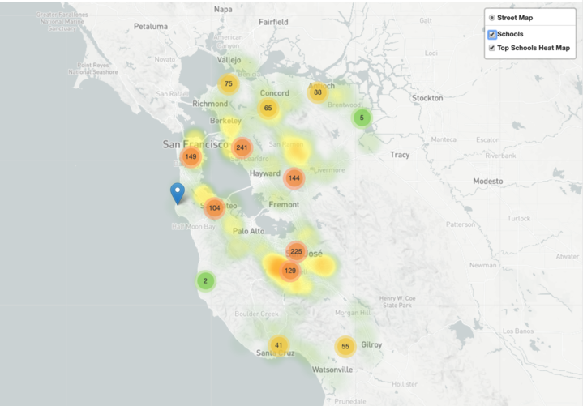
Our map with layers
This map contains a clustered marker view of all the public schools in the Bay Area as well as a heat layer that is scaled to display schools which received the highest gsRating.
The map suggests that the South Bay/Peninsula area would be an excellent location to live in if you value a competitive school environment for your family. This area not only contains the highest concentration of schools, but also the highest average rating.

Slide 6
House prices and Income vs School ratings
Not a huge correlation between Household income and School rating, but we can see some trends

Slide 7
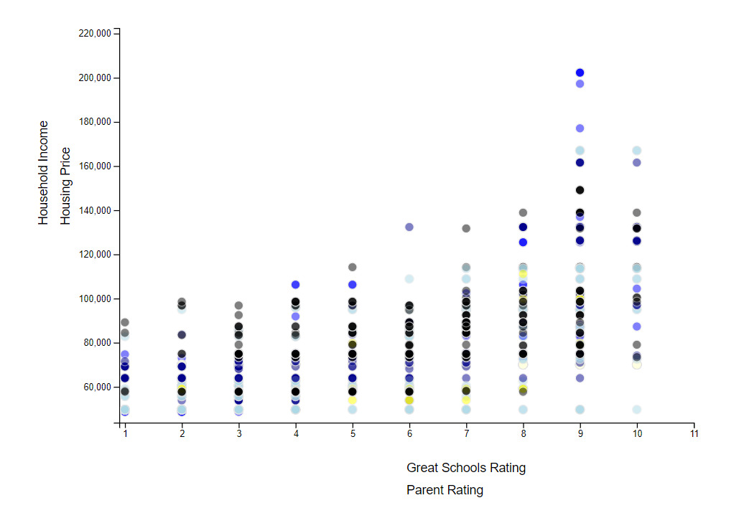
Dynamic scatter plot for school ratings vs household income and housing price
As a school's rating increases, the surrounding household incomes increase slightly; however, the upper limit of household incomes does greatly increase. As a school's rating increases, the surrounding housing prices also increase, but stabilize past a school rating of 7.

Slide 9

Sunburst interactive pie chart

Slide 10
The website
We used Heroku to have an app for user interaction.

